Slide 1
Statistical analysis of phones from the USA and Asian countries
BIA - 500
Team 1
Akhil Meda Vasudeva Murthy Daizy Balar
Mugdha Kamat
Nischith Muddegowda

Slide 2
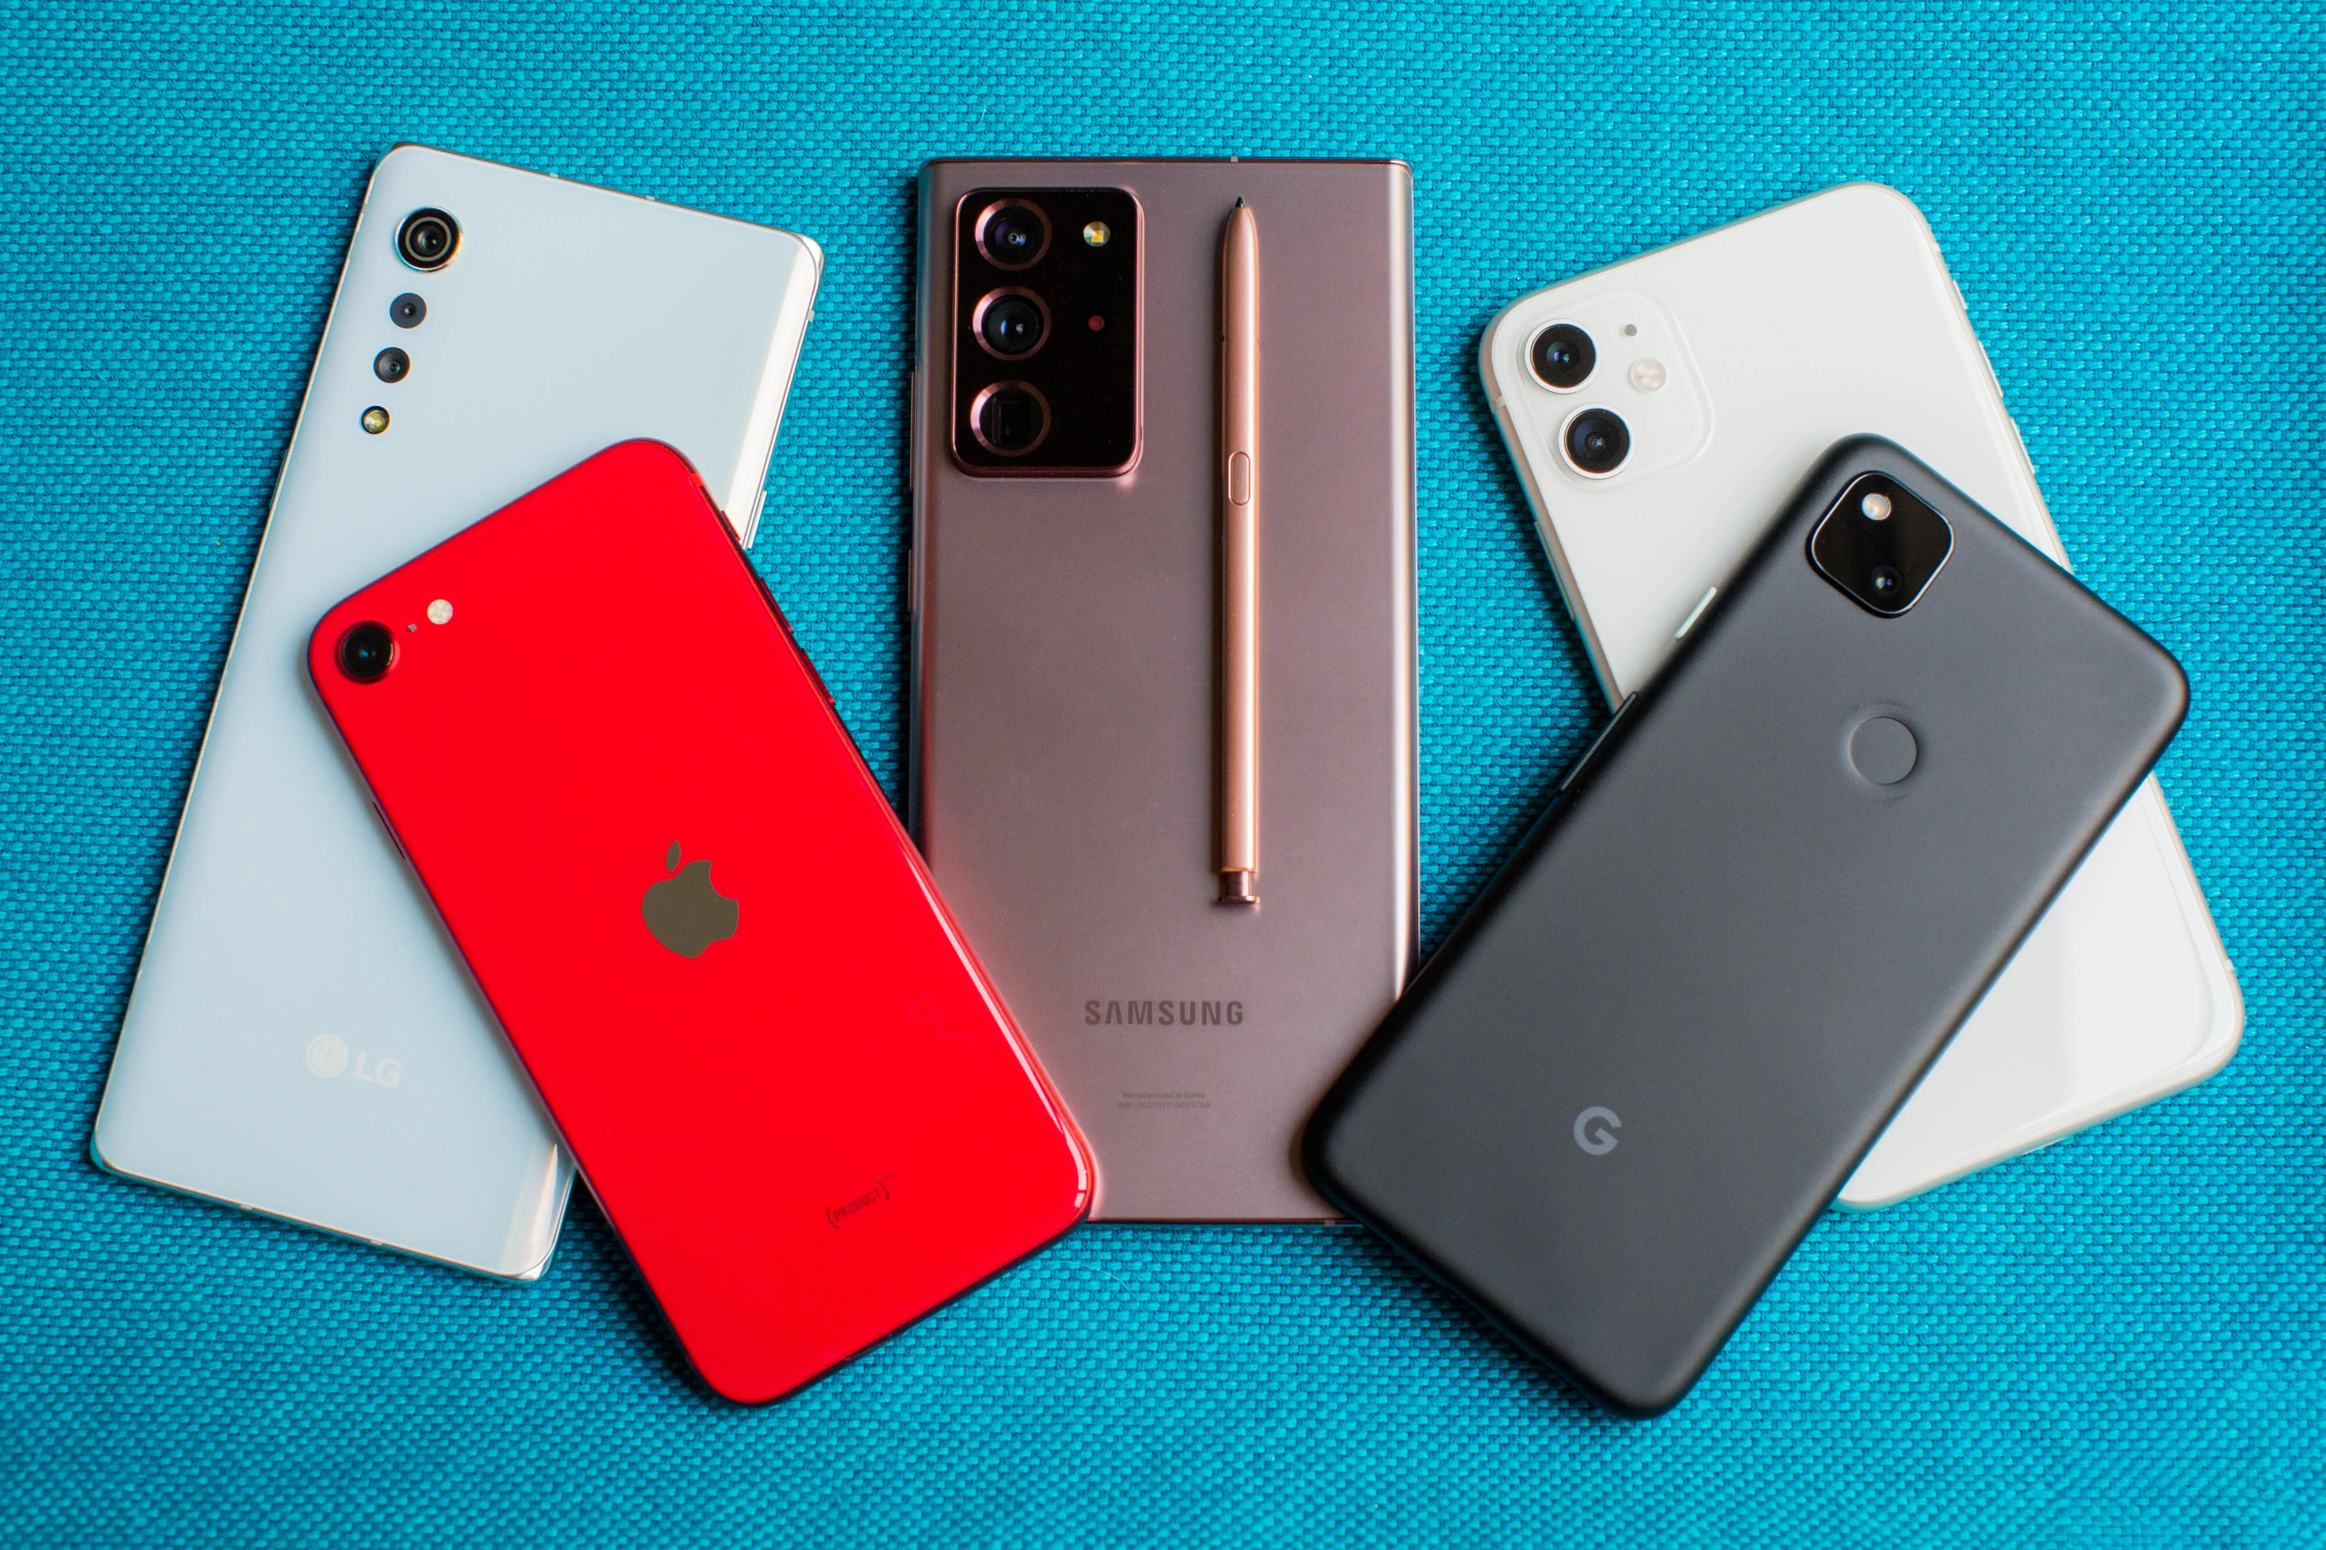
Problem Statement
Determine how the phones from the USA perform against Asian phones in terms of key features such as Camera, Battery, Display, Processor speed and Selfie
Owing to the high influx of mobile phones in the market lately it is getting increasingly challenging to decide the best phone
Asian phones seem to dominate in few features and USA phones excel in some
features
Goal : Statistically analyze the phone models from the two countries and determine the best choice for customer purchase

Slide 3
Dataset Explanation
The dataset consists of DxOMark Mobile ratings and is collected from Kaggle
DxOMark, currently stylized as DXOMARK, is a commercial website described independent benchmark that scientifically assesses smartphones, lenses and cameras
The dataset post cleaning and sampling comprises of following sample sizes
29 US models mobile ratings
35 Asian models mobile ratings
Variables description:
Categorial : Model Name, Brand, Country
Interval: Launch Date
Ratio : Price, Camera, Selfie, Processor speed, Display, Battery
Notes:
Cleaning : Take out the rows which had multiple columns missing, Take out the ones that are outliers, Fill the missing column with average values, Standardize the column values to 100.
Sampling: Multi-level Sampling is based on Categories 1. Asian or USA; 2. Phone Brands(Select the best brands for analysis)

Slide 4
Descriptive Statistics
 | Variable name | Measurement Scale | Mean | Standard Deviation
1 | Camera | Rating out of 100 | 81.78 | 7.46
2 | Selfie | Rating out of 100 | 91.57 | 5.99
3 | Price | Amount in $$ | $ 797 | $ 293.75
4 | Processor Speed | Rating out of 100 | 70.72 | 3.84
5 | Battery | Rating out of 100 | 70.73 | 8.61
6 | Display | Rating out of 100 | 87.52 | 4.93

Slide 5
Visualization 1
Notes:
Select two slides in which USA dominates in one and Asia dominates in the other. Talk about the features against average ratings.

Slide 6
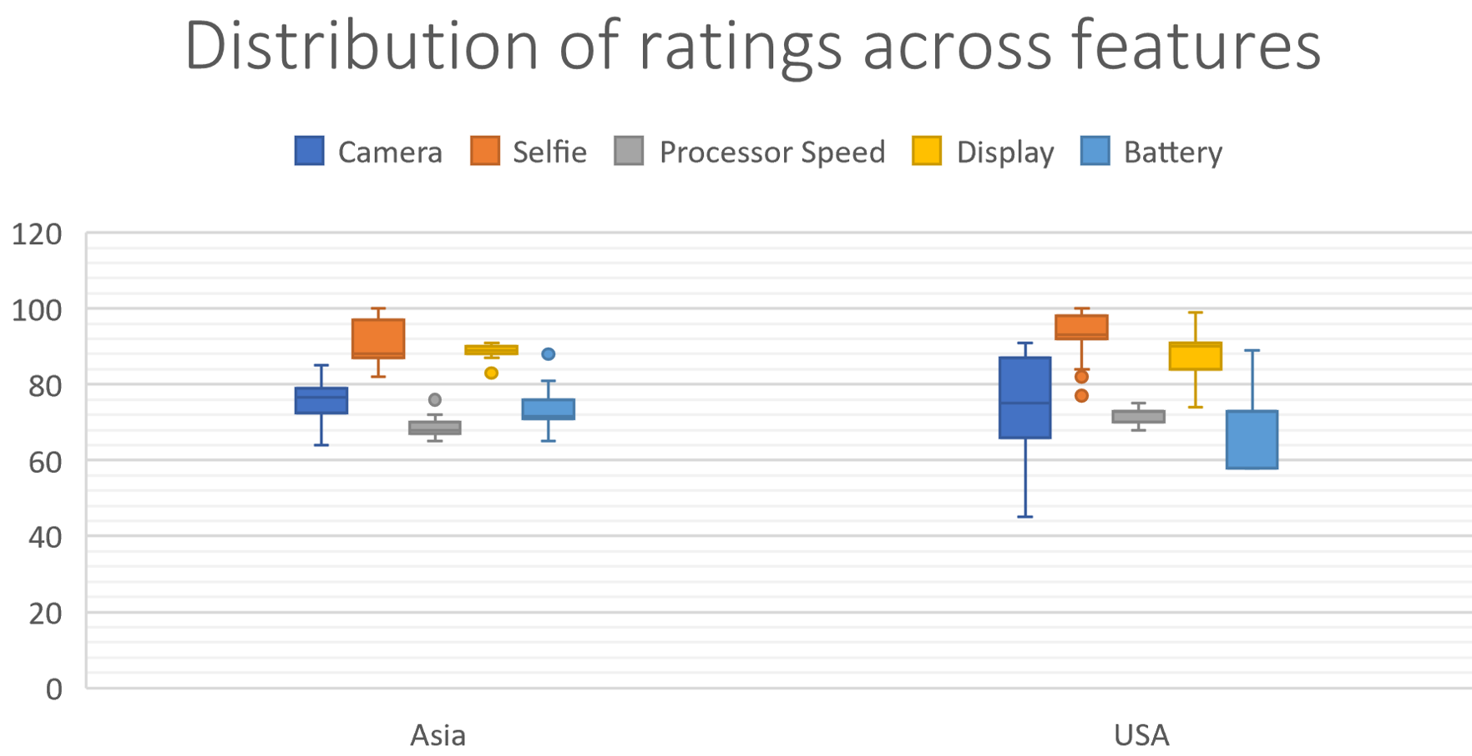
Visualization 2
Notes:
Mugdha – Box plot with cleaned Data (One without outliers)

Slide 7
Analytics
The following experiments are conducted using the key performance indexes(Mobile features)
Experiment 1: Compare the average camera ratings of the US and Asian mobiles to see which one is rated better using the t-test
Experiment 2: Compare the average selfie ratings of the US and Asian mobiles to see which one is rated better using the t-test
Experiment 3: Compare the average performance ratings of the US and Asian mobiles to see which one is rated better using the t-test
Experiment 4: Compare the average pricing for the US and Asian mobiles to determine if there’s any difference between phone pricing using a t-test
Experiment 5: The last experiment determines the significant contributors among features that impact the prices for US and Asian phones accordingly using a Regression Analysis
Notes:
It is on our interest that we selected Camera owing to the recent demand that is around Social Media wrt posting pictures, videos.

Slide 8
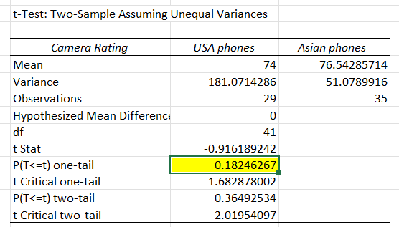
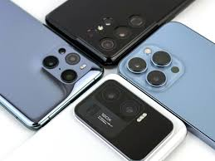
Findings : Experiment 1
H0: USA mobiles are rated lower than or equal to Asian mobiles in phone Camera
H1: USA mobiles are rated higher than Asian mobiles in phone Camera

Slide 9
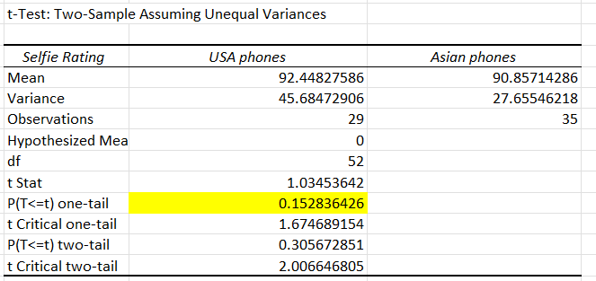

Findings : Experiment 2
H0: USA mobiles are rated lower than or equal to Asian phones in selfie Camera
H1: USA mobiles are rated higher than Asian phones in selfies Camera
Notes:
Mugdha

Slide 10
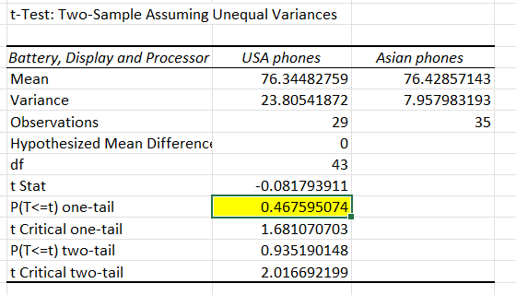

Findings : Experiment 3
H0: USA mobiles perform worse than or equal to Asian phones in Battery, Display and processor speed
H1: USA mobiles perform better in Battery, Display and processor than Asian phones

Slide 11
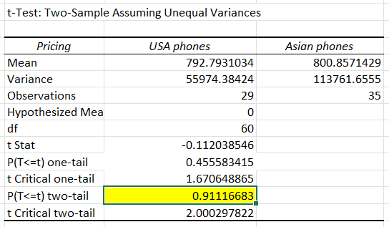

Findings : Experiment 4
H0: There is no significant difference between pricing of Asian and USA phones
H1: There is a significant difference between pricing of Asian and USA phones

Slide 12
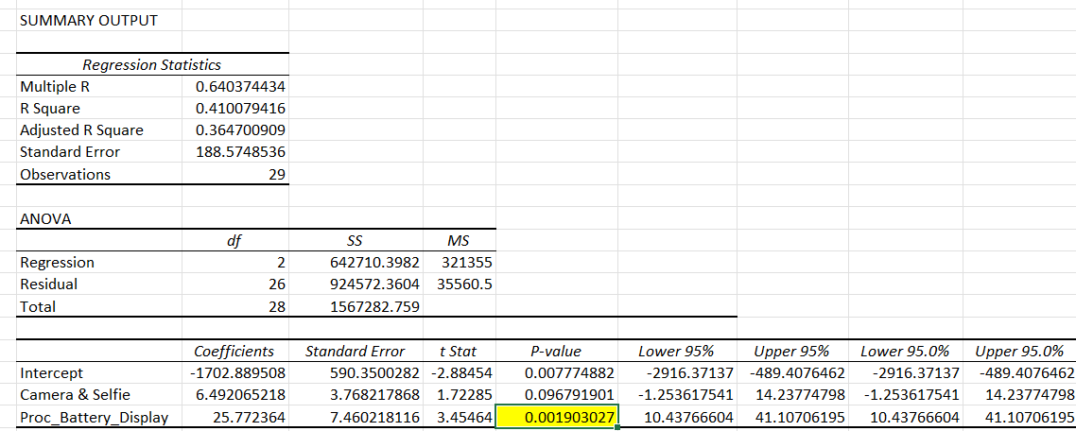
Findings : Experiment 5 (US Mobiles)
Here it can be observed that for US mobiles the performance features - Processor, Battery and Display (Standardized) are the significant predictors for price.

Slide 13
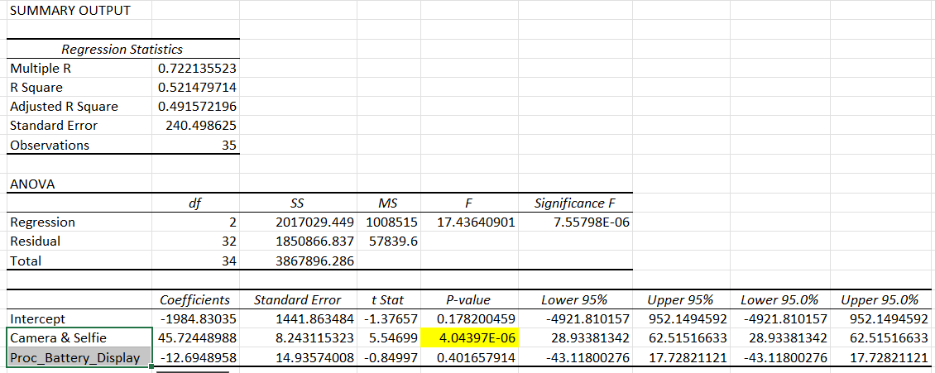
Findings : Experiment 5 (Asian Mobiles)
We can observe that for Asian mobiles, the Camera and Selfie features are the significant predictors for price.

Slide 14
Conclusion and Recommendation
We observed that there is not significant evidence to prove that USA phones are better than Asian phones with respect to key features.
There is no significant evidence to prove the difference in pricing between Asian phones and USA phones.
For Asian phones the significant contributors to the price are Camera and Selfies
For USA phones the significant contributors to the price are Processor, Battery and Display features.
We can conclude that if a customer wants to determine the phone that is best rated for Camera and if camera is a significant contributor to the price, then Asian phones are recommended.
In another case if the customer is interested in phone that is rated best for Battery, Display and processor speed and if these features are significant contributors to the price, then USA phones are recommended.

